Slide 1
Social Contact Networks and Disease Eradicability under Voluntary Vaccination
Ana Perisic, Chris T. Bauch
Department of Mathematics and Statistics, University of Guelph, Guelph, Ontario, Canada

Slide 2
Abstract
Certain theories suggest that it should be difficult or impossible to eradicate a vaccine-preventable disease under voluntary vaccination.
Previous modeling studies of the interplay between disease dynamics and individual vaccinating behavior have assumed that infection is transmitted in a homogeneously mixing population.
By comparison, here we simulate transmission of a vaccine-preventable SEIR infection through a random, static contact network.
This work illustrates the significant qualitative differences between behavior–infection dynamics in discrete contact-structured populations versus continuous unstructured populations.
This work also shows how disease eradicability in populations where voluntary vaccination is the primary control mechanism may depend partly on whether the disease is transmissible only to a few close social contacts or to a larger subset of the population.

Slide 3
Introduction
Interest in infectious disease models that incorporate the effects of human behavior has been growing in recent years. However, most of these models predict that it should never be possible to eradicate a disease under voluntary vaccination, due to nonvaccinating ‘‘free riders’’ that emerge when vaccine coverage is high. This prediction contradicts the fact that smallpox was eradicated under a voluntary vaccination policy in many jurisdictions, and that other diseases such as polio are likewise near eradication. These previous models assumed that populations mix homogeneously. However, for some diseases, such as HIV and smallpox, individuals are more likely to get the disease from certain social contacts. Here we show that using a network model that captures this social structure can reconcile the previous theories to the empirical fact that diseases can be eradicated under voluntary vaccination. When infection is transmitted only through close contacts in the network, then an outbreak can be quickly contained using only voluntary vaccination. However, when infection can potentially be transmitted to almost everyone in the network (such as for measles), a disease outbreak can never be contained using voluntary vaccination. This latter observation may have some relevance to the Measles–Mumps–Rubella autism “vaccine scare.”

Slide 4
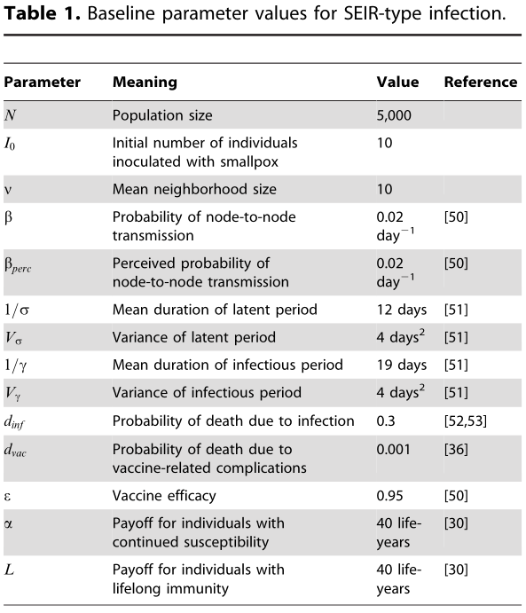

Method
Nbd size of the networks is Poisson-distributed with mean $v$.
We ensured $vI_{0}≪N$

Slide 5
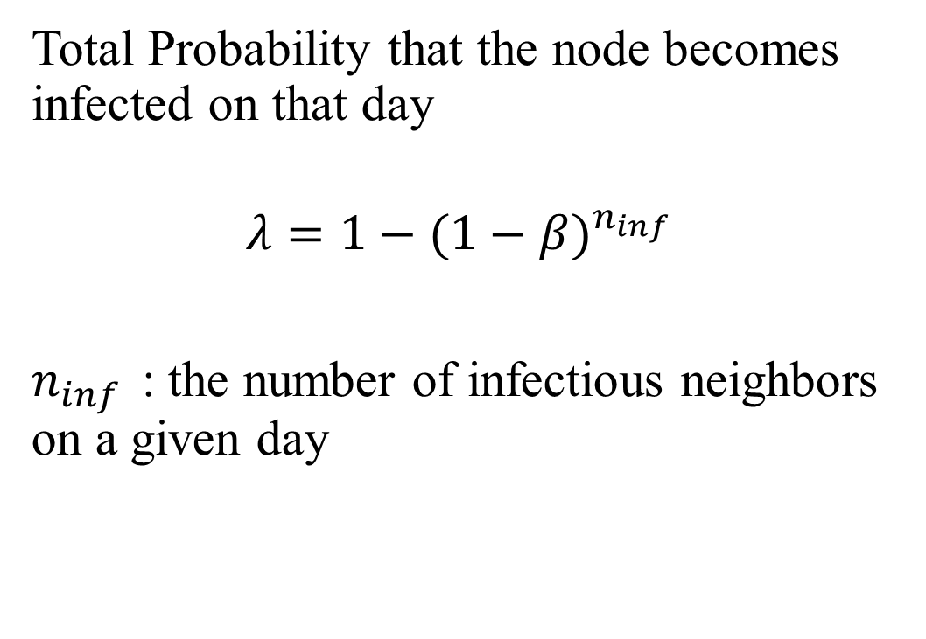
Method
Total Probability that the node becomes infected on that day
$$λ=1−{(1−β)}^{n_{inf}}$$
$n_{inf}$ : the number of infectious neighbors on a given day

Slide 6
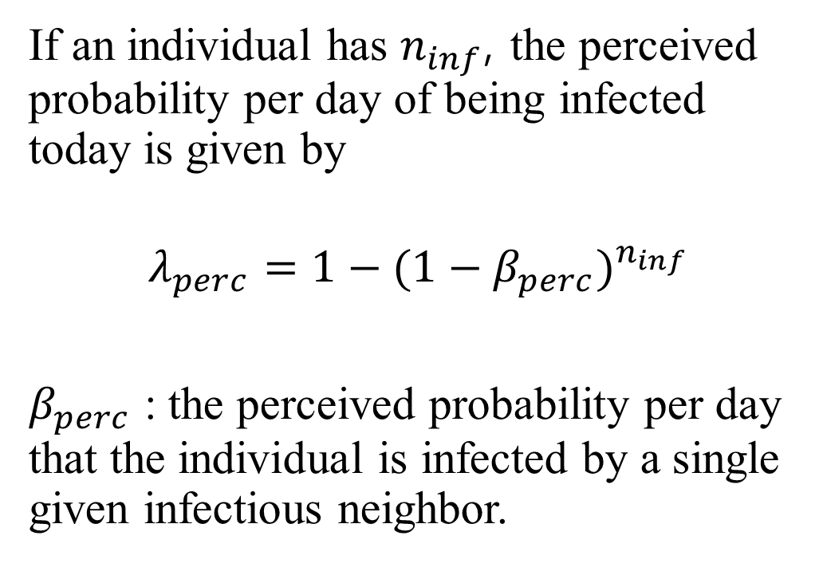
Method
If an individual has $n_{inf}$, the perceived probability per day of being infected today is given by
$$λ_{perc}=1−{(1−β_{perc})}^{n_{inf}}$$
$β_{perc}$ : the perceived probability per day that the individual is infected by a single given infectious neighbor.

Slide 7
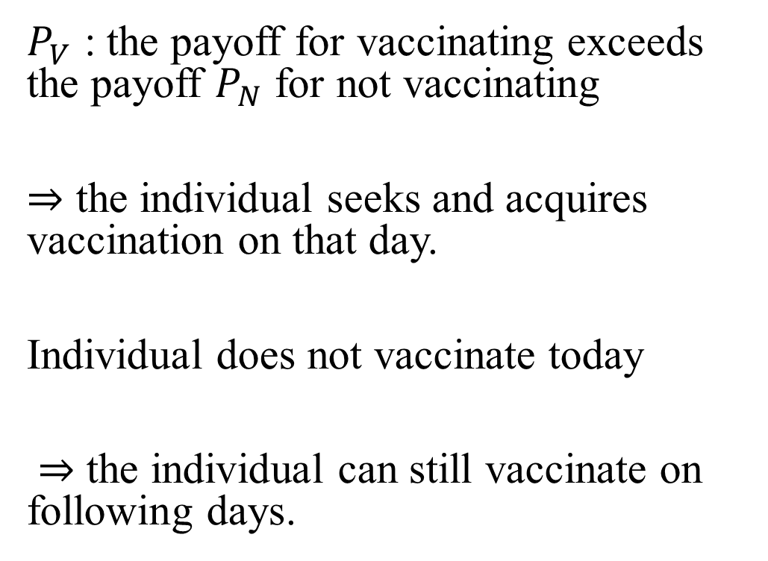
Method
$P_{V}$ : the payoff for vaccinating exceeds the payoff $P_{N}$ for not vaccinating
$⇒$ the individual seeks and acquires vaccination on that day.
Individual does not vaccinate today
$⇒$ the individual can still vaccinate on following days.

Slide 8
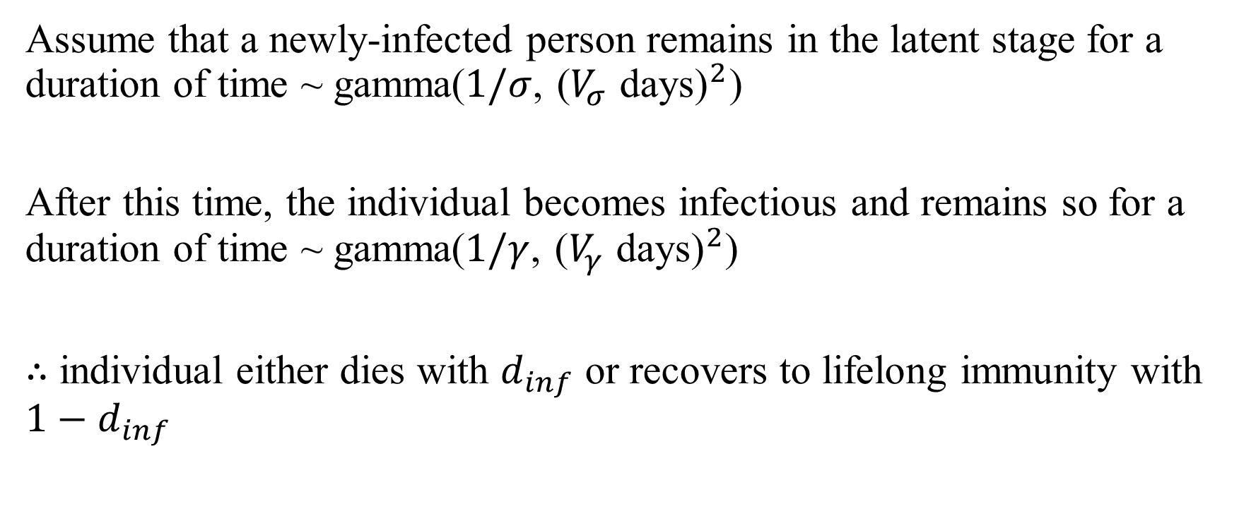
Method : SEIR Infection
Assume that a newly-infected person remains in the latent stage for a duration of time ~ gamma($1/σ$, ${\text{(}V_{σ} \text{days}\text{)}}^{2}$)
After this time, the individual becomes infectious and remains so for a duration of time ~ gamma($1/γ$, ${\text{(}V_{γ} \text{days}\text{)}}^{2}$)
$∴$ individual either dies with $d_{inf}$ or recovers to lifelong immunity with $1−d_{inf}$

Slide 9
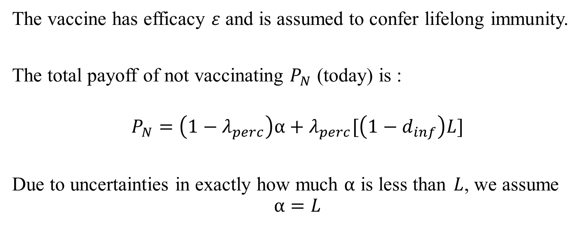
Method : SEIR Infection
The vaccine has efficacy $ε$ and is assumed to confer lifelong immunity.
The total payoff of not vaccinating $P_{N}$ (today) is :
$$P_{N}=\left(1−λ_{perc}\right)α+λ_{perc}[\left(1−d_{inf}\right)L]$$
Due to uncertainties in exactly how much $α$ is less than $L$, we assume
$$α=L$$

Slide 10
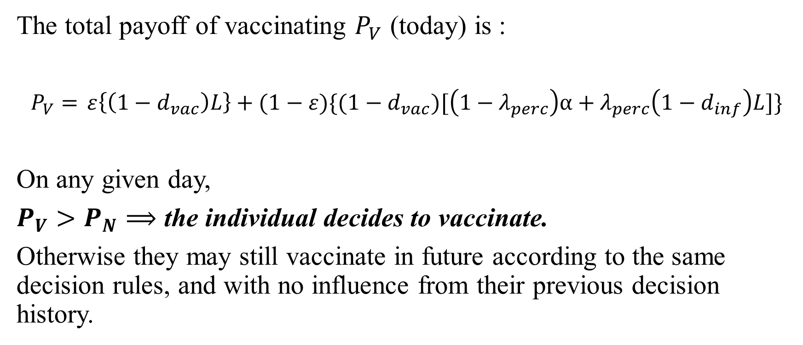
Method : SEIR Infection
The total payoff of vaccinating $P_{V}$ (today) is :
$P_{V}=$ $ε\left\{\left(1−d_{vac}\right)L\right\}+(1−ε)\{(1−d_{vac})[\left(1−λ_{perc}\right)α+λ_{perc}\left(1−d_{inf}\right)L]\}$
On any given day,
$P_{V}>P_{N}⟹$ the individual decides to vaccinate.
Otherwise they may still vaccinate in future according to the same decision rules, and with no influence from their previous decision history.

Slide 11

Method : SEIR Infection
The total payoff of vaccinating $P_{V}$ (today) is :
$P_{V}=$ $ε\left\{\left(1−d_{vac}\right)L\right\}+(1−ε)\{(1−d_{vac})[\left(1−λ_{perc}\right)α+λ_{perc}\left(1−d_{inf}\right)L]\}$
Prob. of Vaccine is efficacious / not efficacious
Payoff that the vaccine is efficacious and no fatal complications ensue
Payoff that the vaccine is not efficacious
Prob. of the individual does not die
Prob. of the individual does is not infected today

Slide 12

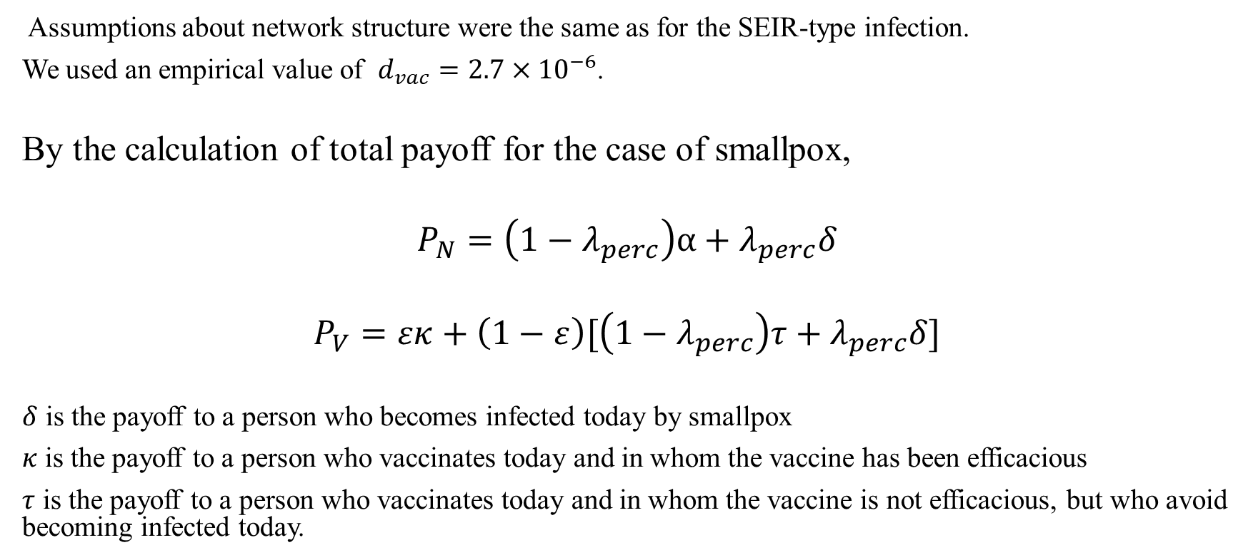
For Smallpox Infection
Assumptions about network structure were the same as for the SEIR-type infection.
We used an empirical value of $d_{vac}=2.7×{10}^{−6}$.
By the calculation of total payoff for the case of smallpox,
$$P_{N}=\left(1−λ_{perc}\right)α+λ_{perc}δ$$
$$P_{V}=εκ+\left(1−ε\right)[\left(1−λ_{perc}\right)τ+λ_{perc}δ]$$
$δ$ is the payoff to a person who becomes infected today by smallpox
$κ$ is the payoff to a person who vaccinates today and in whom the vaccine has been efficacious
$τ$ is the payoff to a person who vaccinates today and in whom the vaccine is not efficacious, but who avoid becoming infected today.

Slide 13
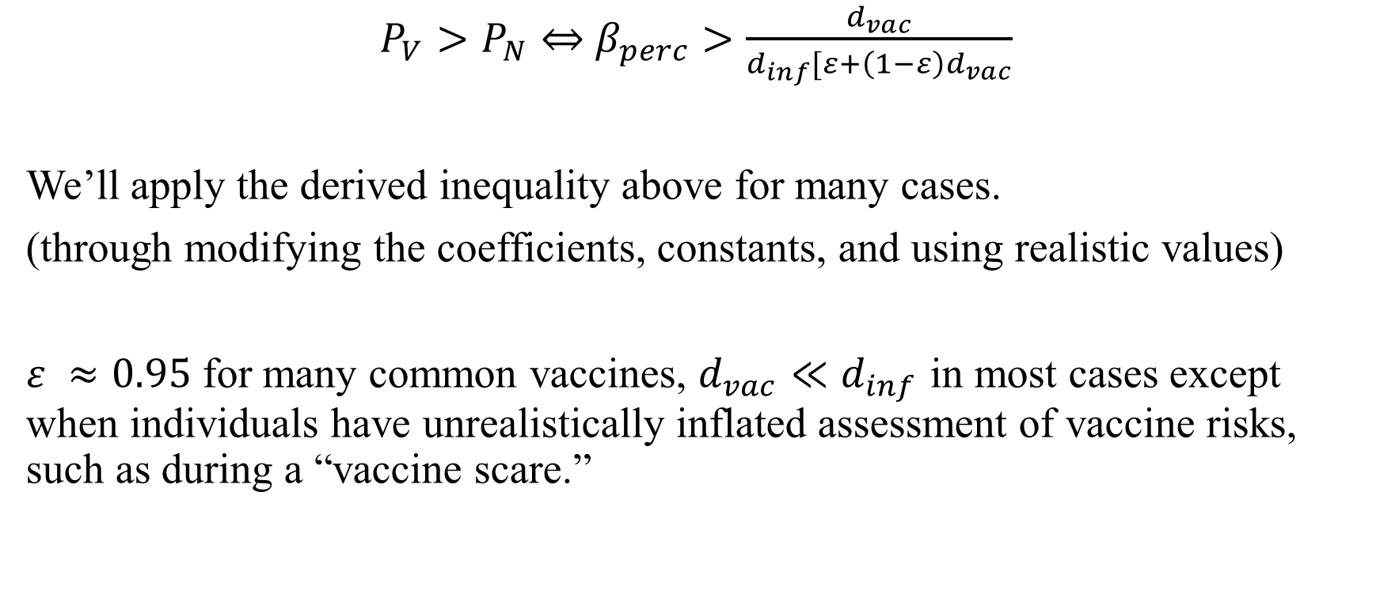
Results
$P_{V}>P_{N}$ $⇔$ $β_{perc}>\frac{d_{vac}}{d_{inf}[ε+\left(1−ε\right)d_{vac}}$
We’ll apply the derived inequality above for many cases.
(through modifying the coefficients, constants, and using realistic values)
$ε ≈0.95$ for many common vaccines, $d_{vac}≪d_{inf}$ in most cases except when individuals have unrealistically inflated assessment of vaccine risks, such as during a “vaccine scare.”
${∗ β}_{perc}$ : the perceived probability per day that the individual is infected by a single given infectious neighbor.

Slide 14
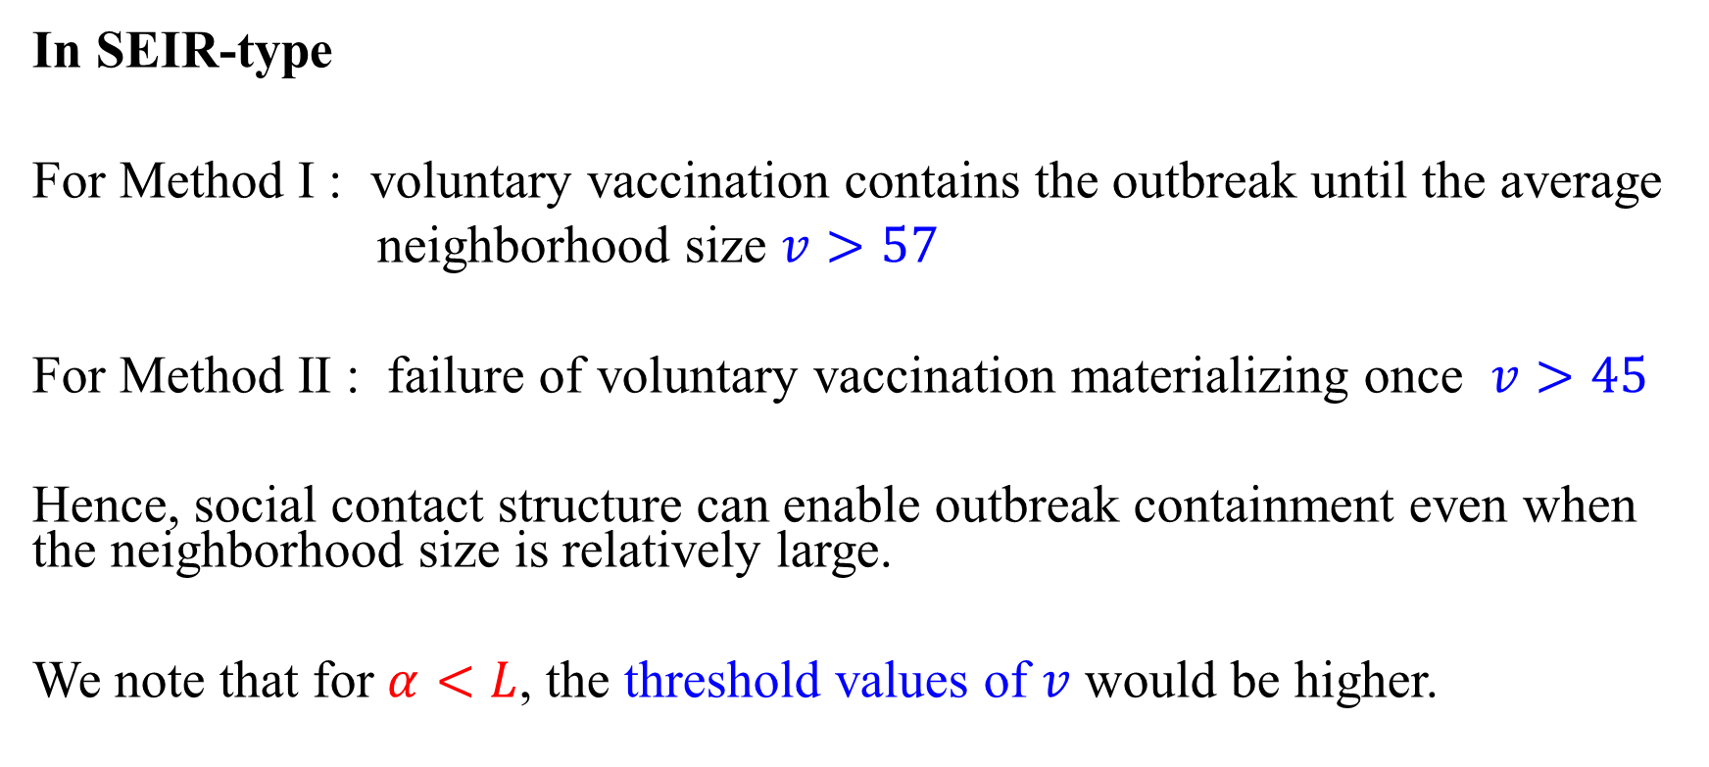
Results – NBD size
In SEIR-type
For Method I : voluntary vaccination contains the outbreak until the average
neighborhood size $v>57$
For Method II : failure of voluntary vaccination materializing once $v>45$
Hence, social contact structure can enable outbreak containment even when the neighborhood size is relatively large.
We note that for $α<L$, the threshold values of $v$ would be higher.
$α$ : payoff for continued susceptibility, $L$ : payoff for lifelong immunity, $v$ : NBD size of the networks

Slide 15
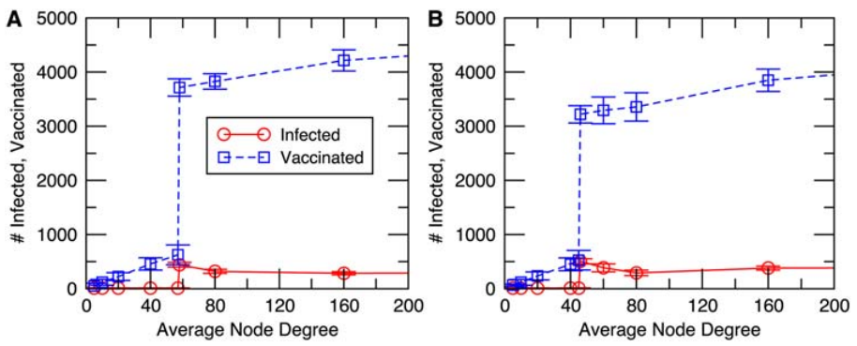
Results – NBD size
Method I, II for final size and number vaccinated vs average neighborhood size for an SEIR-type infection

Slide 16
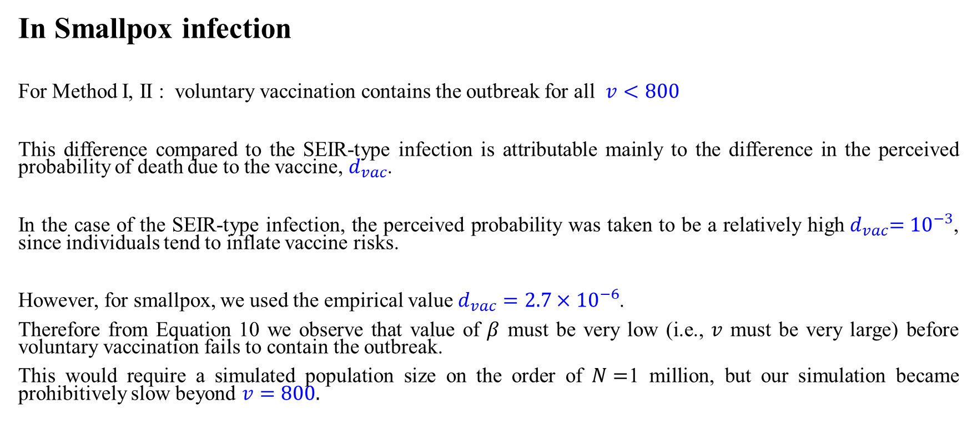
Results – NBD size
In Smallpox infection
For Method I, II : voluntary vaccination contains the outbreak for all $v<800$
This difference compared to the SEIR-type infection is attributable mainly to the difference in the perceived probability of death due to the vaccine,${ d}_{vac}$.
In the case of the SEIR-type infection, the perceived probability was taken to be a relatively high${ d}_{vac}={10}^{−3}$, since individuals tend to inflate vaccine risks.
However, for smallpox, we used the empirical value $d_{vac}=2.7×{10}^{−6}$.
Therefore from Equation 10 we observe that value of $β$ must be very low (i.e., $v$ must be very large) before voluntary vaccination fails to contain the outbreak.
This would require a simulated population size on the order of $N=$1 million, but our simulation became prohibitively slow beyond $v=800.$
${ d}_{vac}$. : Probability of death due to vaccine-related complications

Slide 17
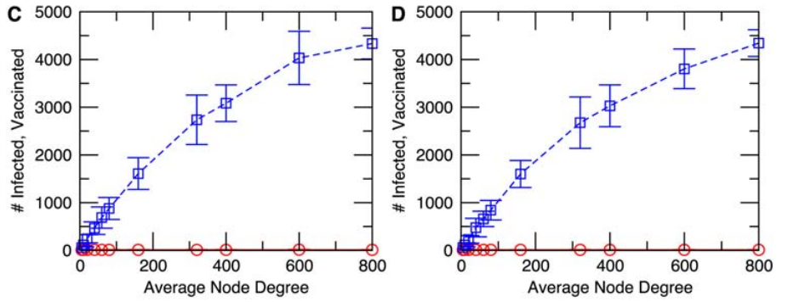
Results – NBD size
Method I, II for final size and number vaccinated vs average neighborhood size for an smallpox infection

Slide 18
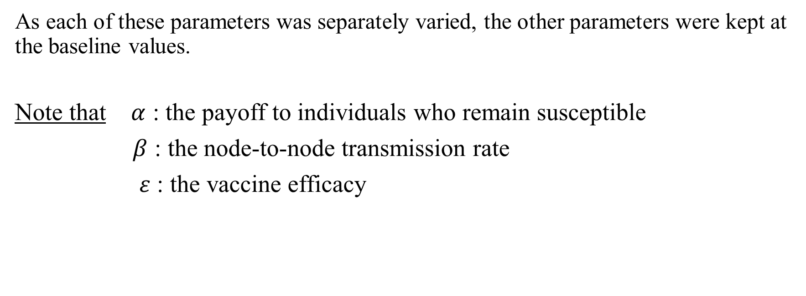

Results - $α, β, ε$
(In univariate sensitivity analysis)
As each of these parameters was separately varied, the other parameters were kept at the baseline values.
Note that $α$ : the payoff to individuals who remain susceptible
$β$ : the node-to-node transmission rate
$ε$ : the vaccine efficacy

Slide 19
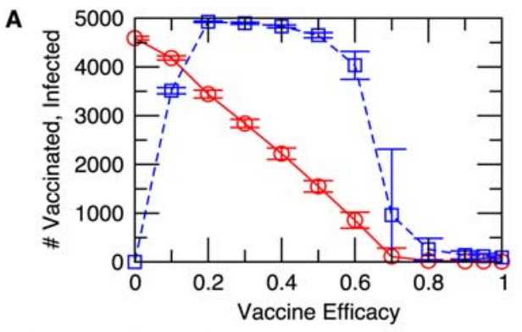
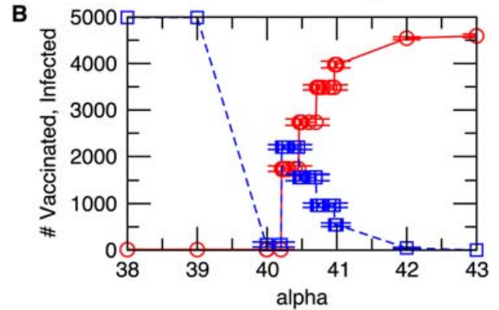
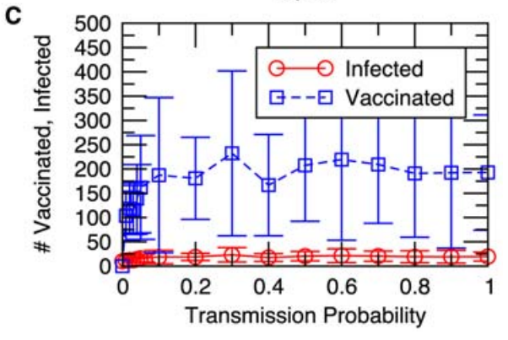
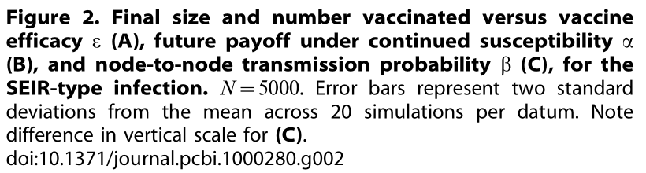
Results - $α, β, ε$
(In univariate sensitivity analysis)

Slide 20
Discussion
Spatially structured population VS Unstructured populations :
They can have a different thing in theoretical population biology.
We observed similar differences :
Network models VS Homogeneous mixing models

Slide 21
Discussion
In Populations mix homogeneously :
Vaccination coverage can be high, but never high enough to eradicate a vaccine-preventable infection.
In Networks where contact structure is sufficiently local:
rapidly and efficiently curtail outbreaks in discrete, contact-structured populations, through voluntary ring vaccination.

Slide 22
Discussion
Spatial structure can also encourage the persistence of cooperative behavior in classical games such as the Prisoner’s Dilemma.
In the case of the Prisoner’s Dilemma, small clusters of cooperating individuals can maintain ‘‘equal footing’’ with clusters of defectors, because of the high cooperate-cooperate payoffs that occur within cooperator clusters.
In the present analysis the mechanism is quite different, having to do with the large difference in infection risk between those who neighbor infectious individuals and those who do not.
This individual-level structure cannot be described in a homogeneously mixing population subject to the continuum approximation.

Slide 23
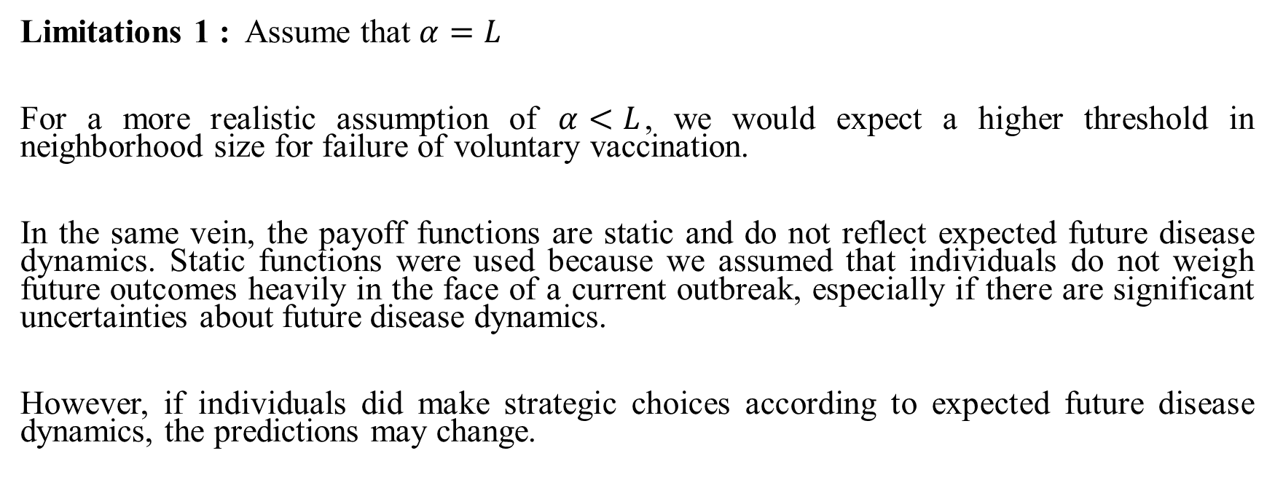
Discussion
Limitations 1 : Assume that $α=L$
For a more realistic assumption of $α<L$, we would expect a higher threshold in neighborhood size for failure of voluntary vaccination.
In the same vein, the payoff functions are static and do not reflect expected future disease dynamics. Static functions were used because we assumed that individuals do not weigh future outcomes heavily in the face of a current outbreak, especially if there are significant uncertainties about future disease dynamics.
However, if individuals did make strategic choices according to expected future disease dynamics, the predictions may change.

Slide 24
Discussion
Limitations 2 : used a static, random network.
Outcomes may differ for other types of networks. For instance, in a network with small characteristic path length, infection and vaccination should percolate through the network more quickly than was the case here, although we do not expect the final state of the network to change.
Similarly, networks with scale-free neighborhood size distributions may exhibit highly variable outcomes due to the large heterogeneity in neighborhood size.

Slide 25
Discussion
Limitations 3 : if network edges can form and be dissolved, then failure of voluntary vaccination should emerge for a sufficiently high rate of turnover of network edges, regardless of neighborhood size.

Slide 26
Discussion
Future work : On behavior-infection dynamics in contact-structured populations, we should take into account more realistic networks such as those derived from household sizes, sexual behavior surveys, or contact-dairy studies.

Slide 27
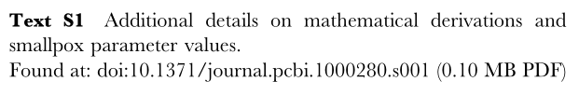
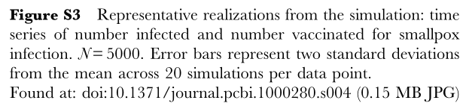
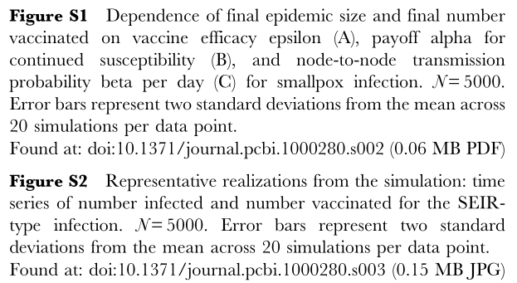
Supporting Information

